Slide 1
Scholarships
Mrs. Hall’s Office
-Sign up for the SAT here!
Military Dependent Scholarships
-sign up for the act here!
-take a virtual college tour here!
-attend a virtual college fair here
Fill out these forms ASAP!
FEE Waiver Application
Student Release Form
Additional
Resources

Slide 2
Senior FAFSA INFO
FAFSA SEASON BEGINS OCTOBER 1, 2021
APPOINTMENTS WILL BEGIN OCTOBER 4, 2021
MAKE YOUR APPT. WITH ME HERE (TAKE NOTE OF LIST OF ITEMS TO BRING)
CREATE YOUR FSA ID FOR YOU AND ONE PARENT HERE BEFORE OUR APPT.
FILL OUT THE FAFSA CONSULTATION FORM HERE AND ACCESS FORM HERE BEFORE OUR APPT.

Slide 3
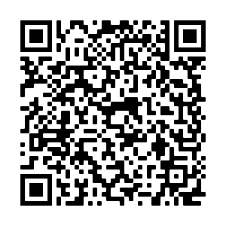
SENIORS, please fill out these forms as soon as possible
Senior survey
Please fill this out now!
RELEASE FORM
FILL OUT NOW IF YOU ARE 18!
FILL OUT WITH PARENT IF UNDER 18
FEE WAIVER APPLICATION
(FREE SAT, ACT, AND COLLEGE APPS)
FILL OUT WITH YOUR PARENT ASAP!

Slide 4
Career and Internship Opportunities
Ship repair. https://www.virginiashiprepair.org/ The application process can be found at this link. http://www.shiprepairtraining.com/
CDL Truck Driving https://www.shipperschoice.com/
Cosmetology https://paulmitchell.edu/virginiabeach
Real Estate https://alphacollegeofrealestate.com/
ATI (auto, commercial driving, diesel vehicle, hvac, welding) https://auto.edu/
TCC https://www.tcc.edu/
Nursing https://sentara.edu/
Culinary https://www.ecpi.edu/college-of-culinary-arts/programs/culinary-arts or https://www.artinstitutes.edu/
VB Tech Center https://techcenter.vbschools.com/
VB ACT https://advancedtechnologycenter.vbschools.com/
ECPI https://www.ecpi.edu/
Military sealift command HTTPS://SEALIFTCOMAND.COM/
Military usa.gov/join-military

Slide 5
Juniors
please fill out these forms as soon as possible
RELEASE FORM
FILL OUT WITH PARENT IF UNDER 18
FEE WAIVER APPLICATION
(FREE SAT, ACT, AND COLLEGE APPS)
FILL OUT WITH YOUR PARENT ASAP!
Junior survey
Please fill this out now!

Slide 6
JUNIOR KHAN ACADEMY (SAT PREP)
YOU MUST FILL OUT THIS FORM TO PARTICIPATE
LINK YOUR KHAN ACADEMY AND COLLEGE BOARD ACCOUNTS.
HERE IS A TUTORIAL
ADD ME AS YOUR COACH USING THIS CLASS CODE: AE4HDYJD
EMAIL ME FOR NEXT STEP
AMYHALL@ACCESSCOLLEGE.ORG OR AHALL834@NPS.K12.VA.US

Slide 7
Junior resources

Slide 8
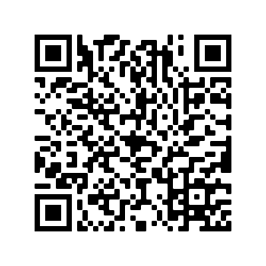
SOPHOMORES
please fill out tHIS FORM now
10th grade resources
10TH GRADE SURVEY

Slide 9
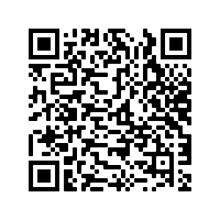
FRESHMEN
please fill out tHIS FORM
9th grade resources
9TH GRADE SURVEY

